Slide 1
How Property Amenities and Locality Affect Housing Prices in Bangalore
By: Thomas Jones

Slide 2
Capstone
How Property Amenities and Locality Affect Housing Prices in Bangalore
By: Thomas Jones
For: Springboard Data Science Career Track
10/7/2021

Slide 3
Bangalore
Bangalore, officially known as Bengaluru, is the capital and the largest city of the Indian state of Karnataka. It has a population of more than 8 million and a metropolitan population of around 11 million, making it the third most populous city and fifth most populous urban agglomeration in India. Located in southern India on the Deccan Plateau, at a height of over 900 m (3,000 ft) above sea level, Bangalore is known for its pleasant climate throughout the year. Its elevation is the highest among the major cities of India.

Slide 4
Data
The data set that I used was found in Kaggle https://www.kaggle.com/ruchi798/housing-prices-in-metropolitan-areas-of-india?select=Kolkata.csv it was satisfying the requirements for this project.
The data set in Kaggle included a total of 6208 properties. Unfortunately many of them had missing data including a major one for my research. I had to reduce the data set to 1856 properties that included information for most of the 40 different variables. The variable had descriptions of amenities and features for each property. For each property there was information on the price, the neighborhood that it was located in, the square footage, the region/state the property was located in, number of times it was sold. In addition information regarding amenities included in the building was also in the data set such as elevator, maintenance, cafeteria, garden, gymnasium, etc. Extraneous data regarding the appliances and furniture that the apartment or house offered were also included in some cases, and conclusions on if the apartment was furnished or not, was possible to be reached.

Slide 5
Variables
Price: Numeric variable expressed in local currency Rupees
Area: Numeric variable expressed in Square footage
Number of Bedrooms: Integer variable
Region: Categorical with 7 levels (North, South, East West, Central, North East, South East)
Resale: Boolean variable identifying if the property was sold or only had one owner
Multipurpose Room: Boolean variable identifying if the building has a multipurpose room
Rainwater Harvest: Boolean variable identifying if the building has a rainwater harvest
Car Parking: Boolean variable identifying if the building has car parking
Intercom: Boolean variable identifying if the building has an intercom
Cafeteria: Boolean variable if the building has one
Landscaped Gardens: Boolean variable identifying if the building has a landscaped garden
Fitness Facilities: Integer variable enumerating the number of fitness amenities the building or neighborhood offers
Vaastu Compliant: a science (shastra) of arranging the five elements – earth, water, fire, air and sky

Slide 6

Exploratory Data Analysis

Slide 7
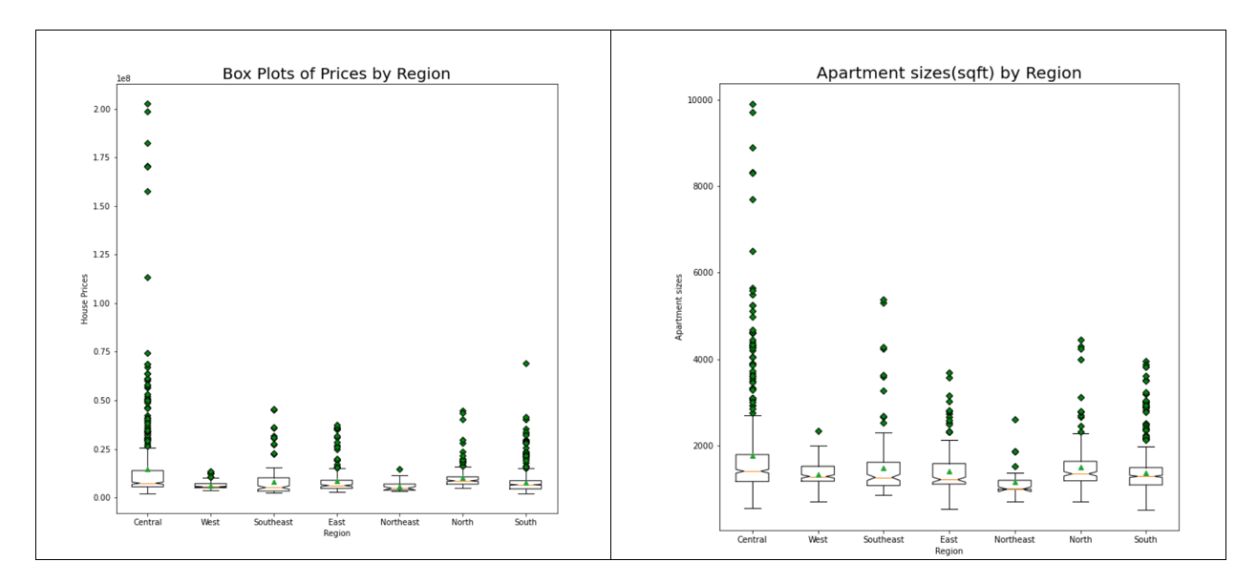
Price by Region

Slide 8
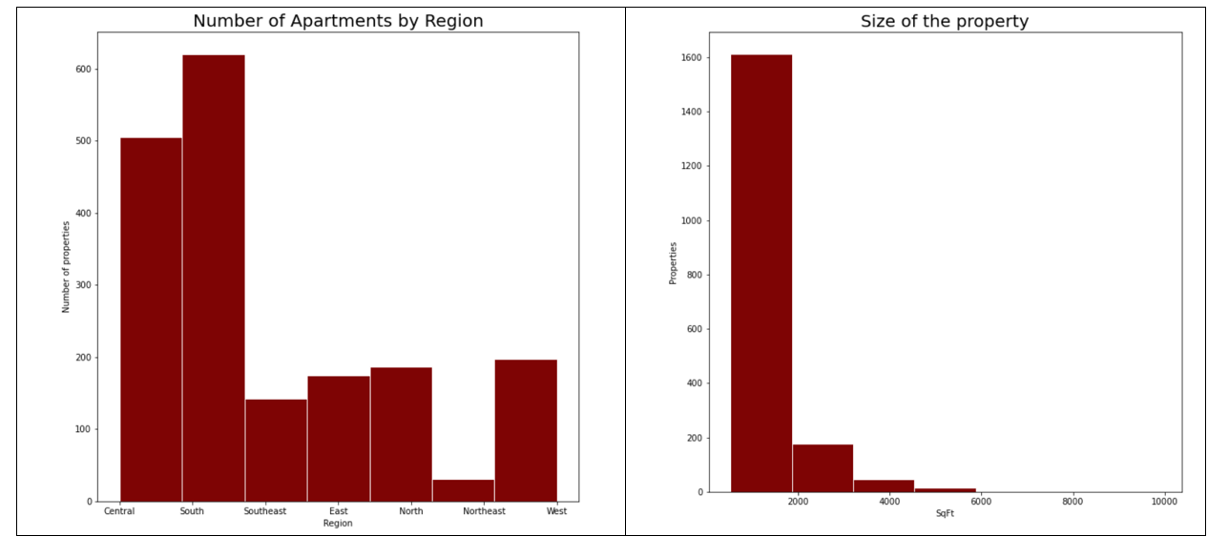
Other Major Variables

Slide 9
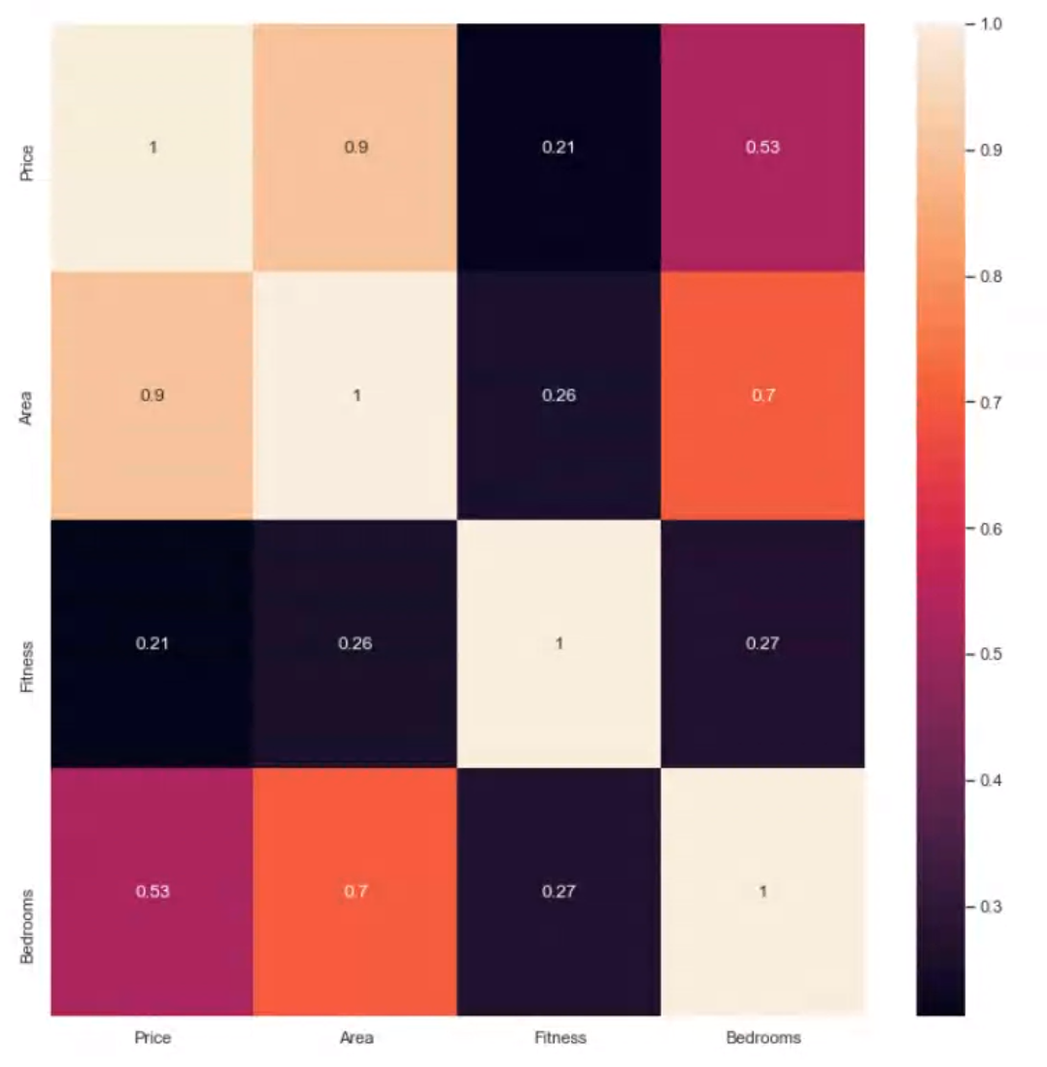
Correlation Analysis of major variables
Expected results of highest correlation on
Number of bedrooms and Price and
Area and Price
with high multicollinearity on
Area and Bedrooms

Slide 10
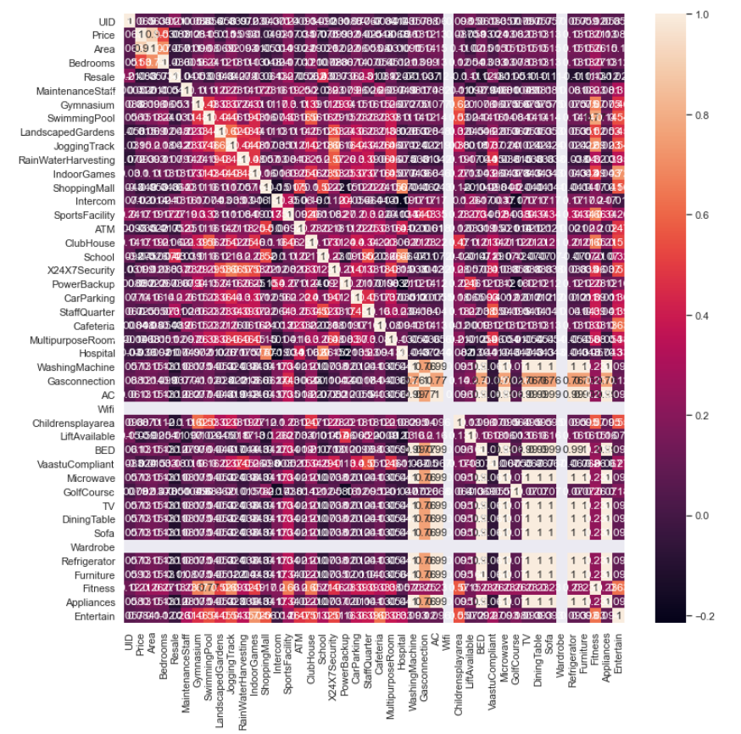
Matrix in its entirety

Slide 11
Problem Statement
Not being a native of Bangalore I used the data provided to better understand the real estate market in the area with a goal to help my business customer form an opinion on how to best invest in Bangalore real estate. The problem is multifaceted as every business problem the focus is to limit cost and increase revenue. In order to do this efficiently we need to understand all the underlying factors that shape the prices of the real estate today and in the past but also those that will affect the prices in the future. The main goal is to identify the factors that affect the real estate price in Bangalore but Bangalore is not just a single neighborhood but rather is a state with a population of 11 million. The prices of the real estate have different trends and are affected by different factors depending on the region of Bangalore they are. The goal is to find the median price of the real estate in the entire region.

Slide 12
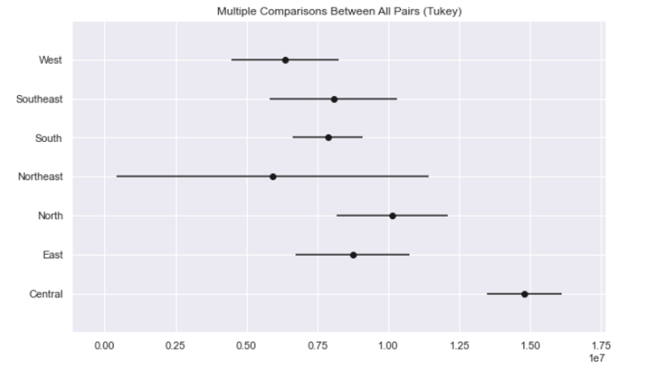
ANOVA
In order to complete the statistical analysis to
support my findings I ran an ANOVA and a Tukey
test. The graph shows us that the difference in
average price is small but higher cost in the Central
in comparison with every other region. The East, Southeast, South, and West regions have similar averages and ranges of prices. The North region has slightly higher prices. Northeast has a big range. While Central is not similar to any of the others with the mean price being much higher

Slide 13
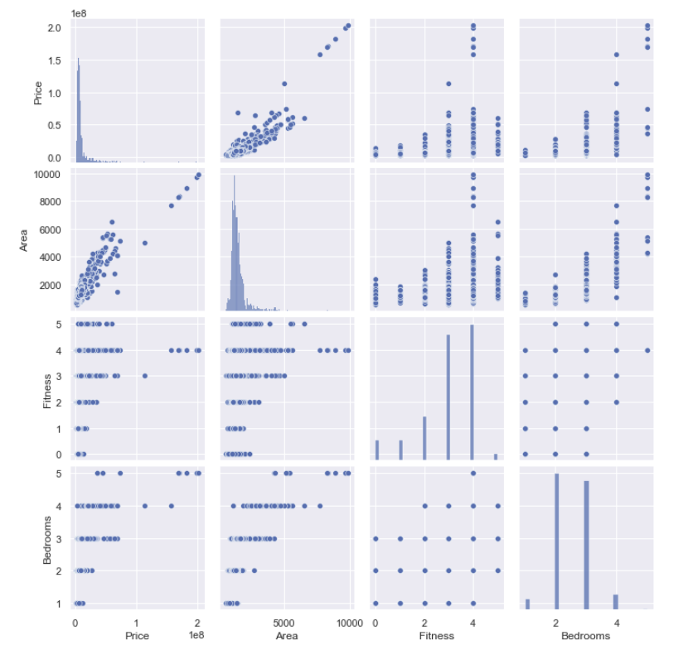
Correlation Matrix

Slide 14
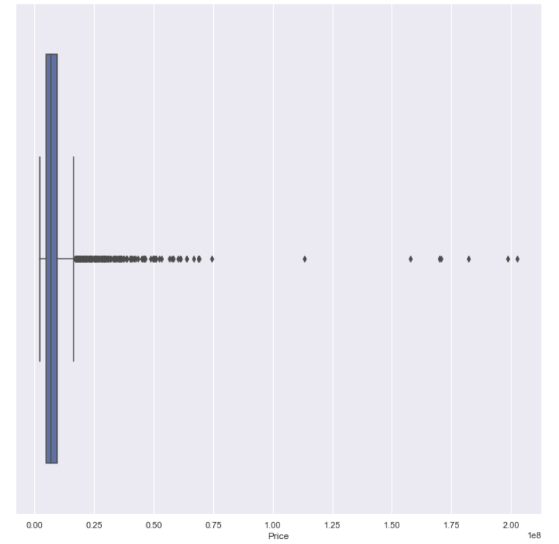
Linear Regression of the price with Gradient Boosting

Slide 15
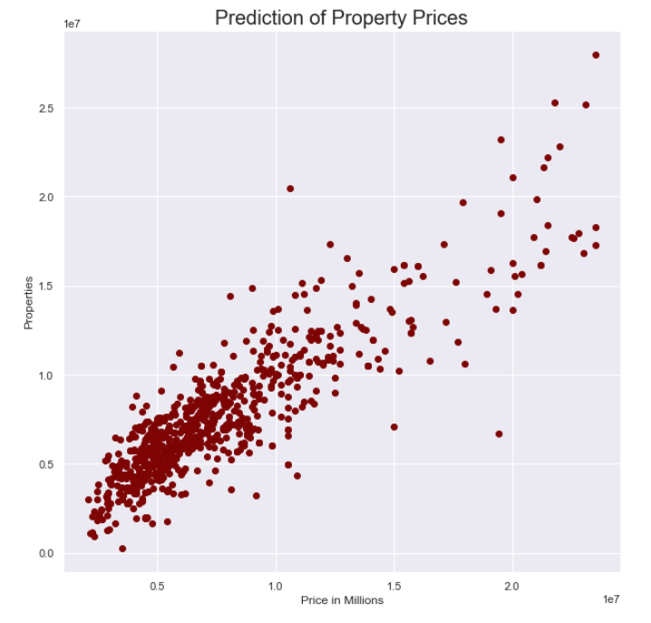
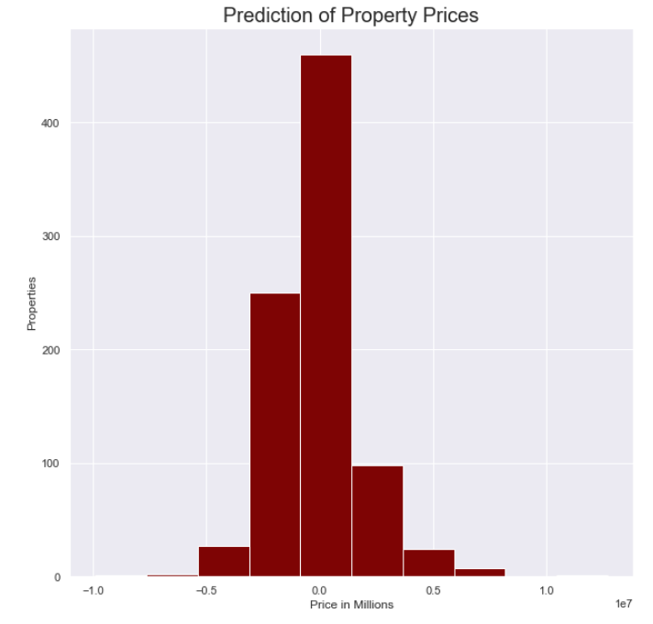
Prediction of Property Prices

Slide 16
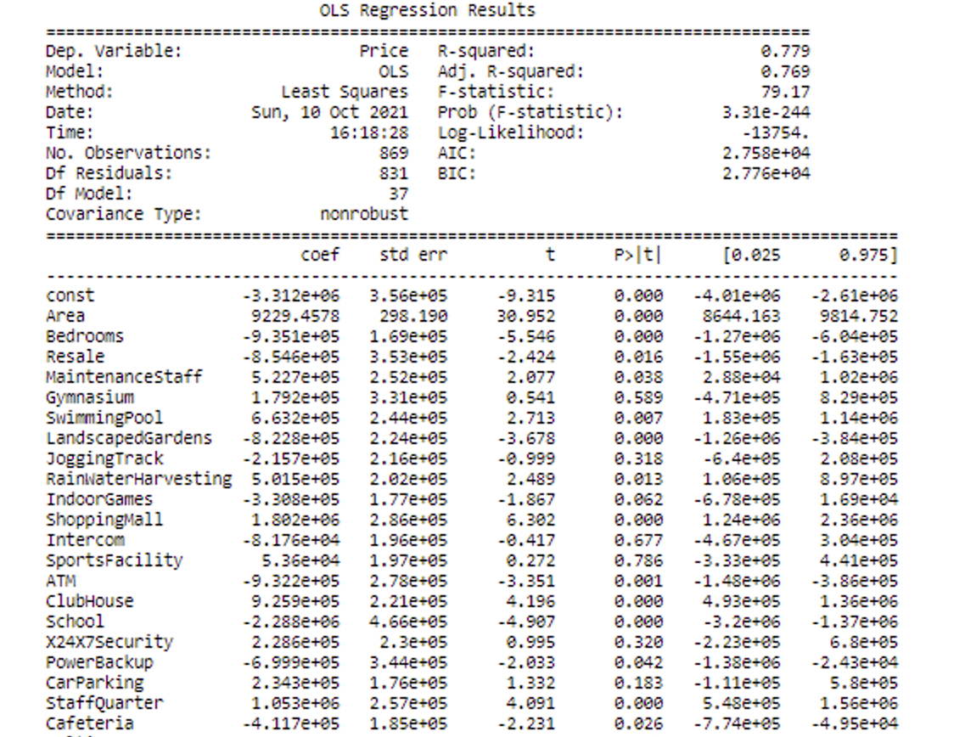
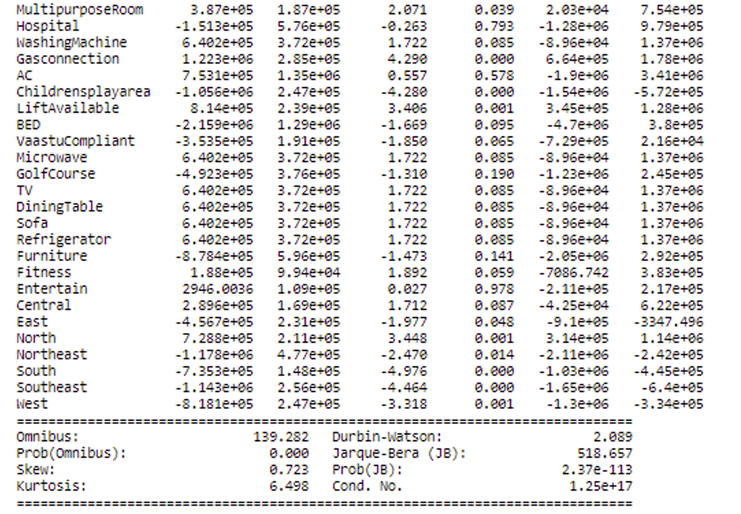
Multi Linear Regression

Slide 17
Conclusion
After completing the research with data of real estate properties in Bangalore, I feel confident to advise the customer regarding prices of properties, identifying preferable locations, and comparing property amenities and their impact to the property price.
Both the simple linear regression and the machine learning implementation verified that the location of Bangalore with highest spread of value was Central and the one that is more uniform in terms of amenities of properties and sizes of apartments was northeast. As expected the size of the property was the most important factor that determines the price of the property while other extraneous factors such as region “location”, luxury amenities such as fitness, entertainment were also important factors that affected the price. The convergence of the regression gave a mean price close to 10,000,000 rupees.

Slide 18
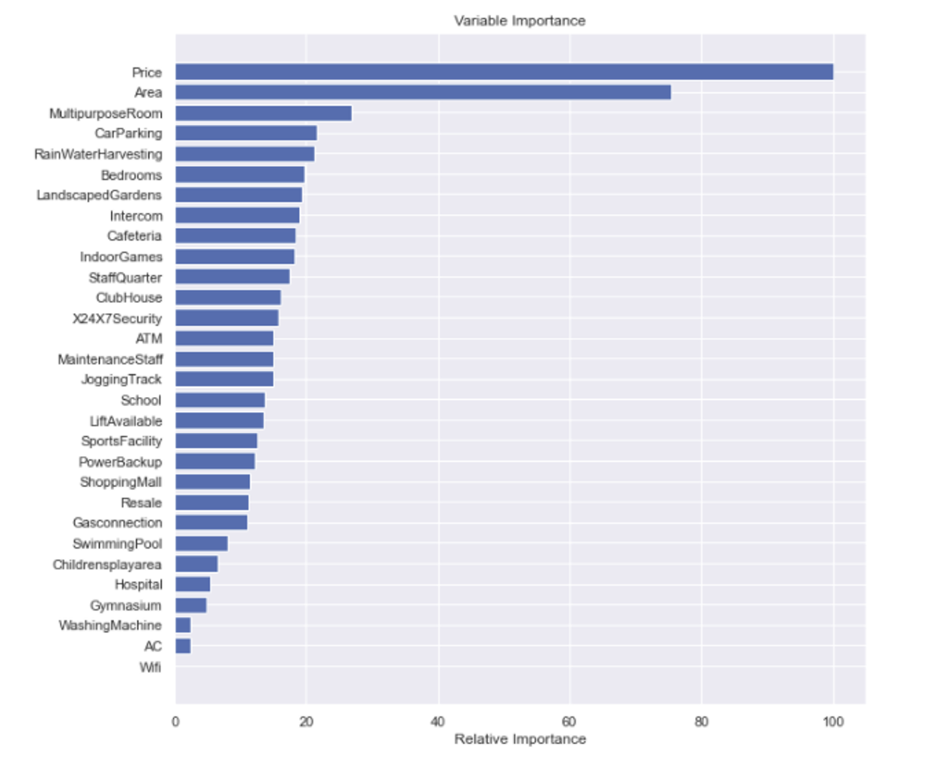
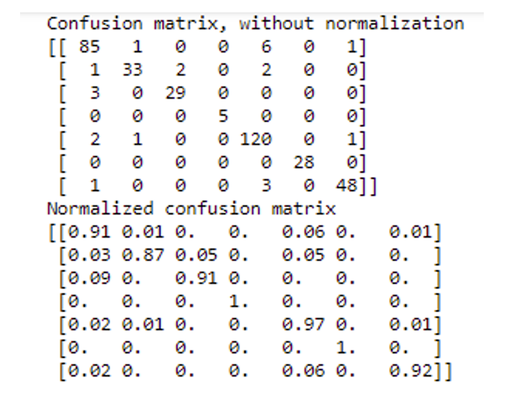
Future Research: Classifying Regions

Slide 19
Future Research: Classifying Regions
My logistic regression predicts the region of a given apartment/house using the set of 40 variables. The results were quite interesting and had a very high accuracy of 93.5%. The main predictor of the region is the price of the apartment. Although somebody would expect the area to also be one of the most important predictors this doesn't seem to be the case. We can see that variables that define if a region is cosmopolitan area are the ones that are good predictors.

Slide 20
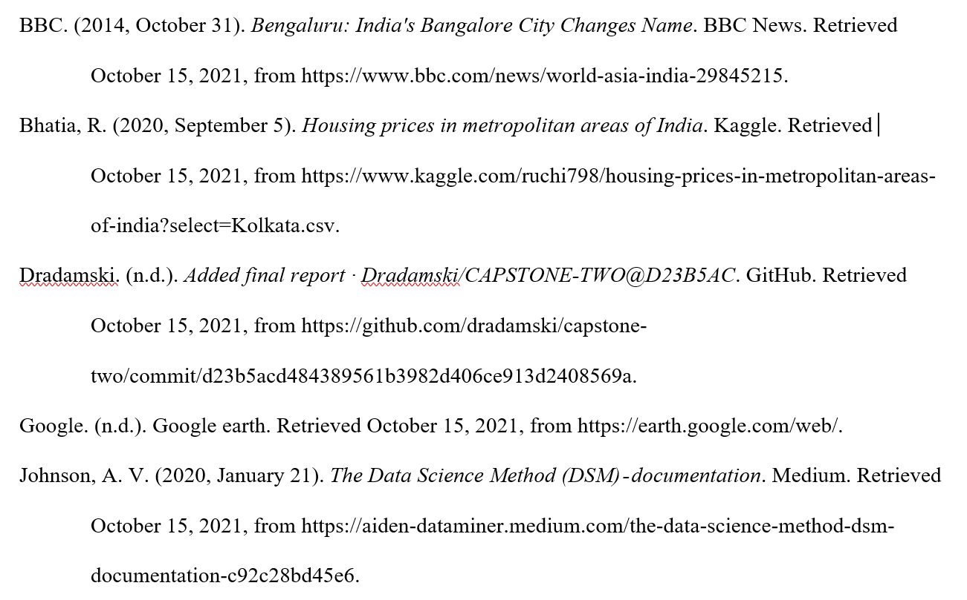
References

